Slide 1
Introduction of physiology
Dr.sahar jabbar kadhum

Slide 2
Physiology
- Introduction
-Physiology of Body fluids
- Physiology of Blood
- Physiology of Gastro-intestinal tract
- Physiology of Cardiovascular system
- Physiology of Respiratory system

Slide 3
- Cell physiology
- Physiology of Autonomic nervous system
- Physiology of Central nervous system
- Renal physiology and acid-base balance
- Endocrine and reproductive physiology
- Physiology of the skin and related structures
- Special senses: Vision, Hearing, Touching, Smelling and Tasting.

Slide 4
Human physiology
is the study of functions of the human body that can be divided into the following types:
Cell physiology.
This is the cornerstone of human physiology; it is the study of the functions of cells.
Special physiology
This is the study of the functions of specific organs. For example, renal physiology is the study of kidney function.

Slide 5
Systemic physiology
It includes all aspects of the function of the body systems, such as cardiovascular physiology, respiratory physiology, reproductive physiology etc..
Pathophysiology
It is the study of the effects of diseases on organ or system functions (pathos is the Greek word for disease).

Slide 6
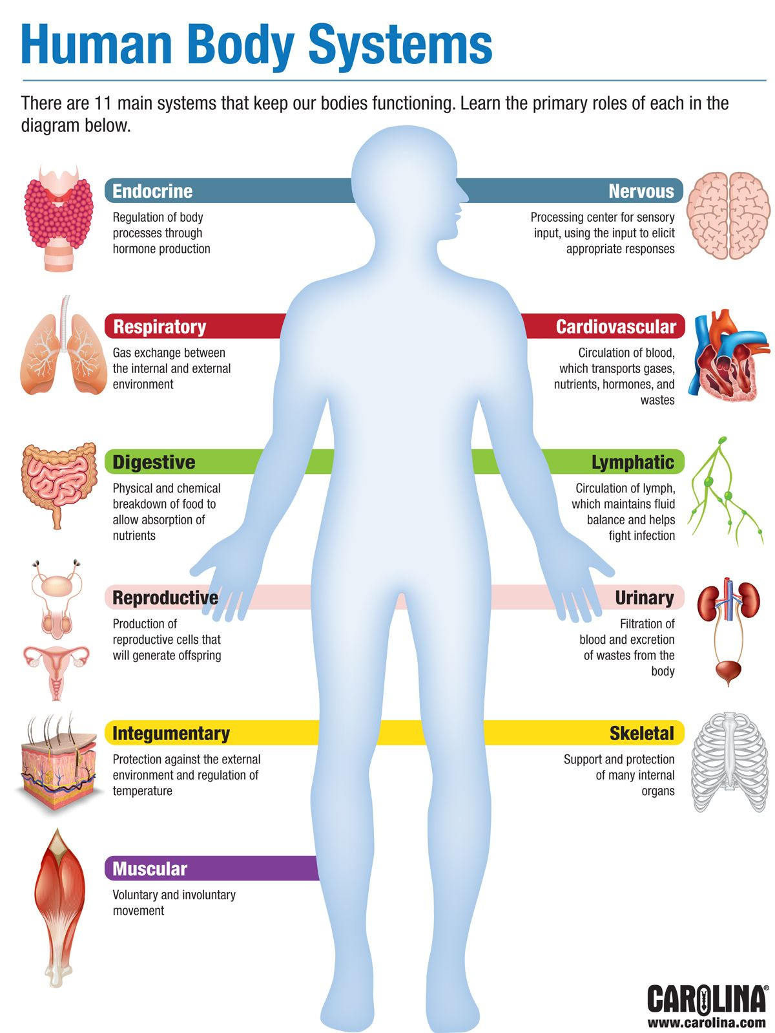

Slide 7
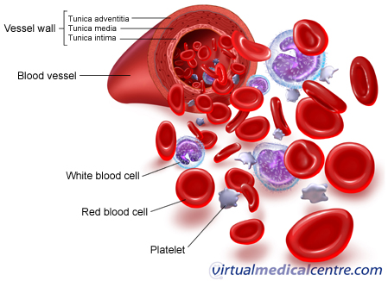

Slide 8
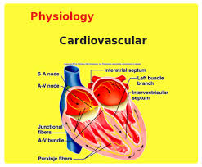

Slide 9
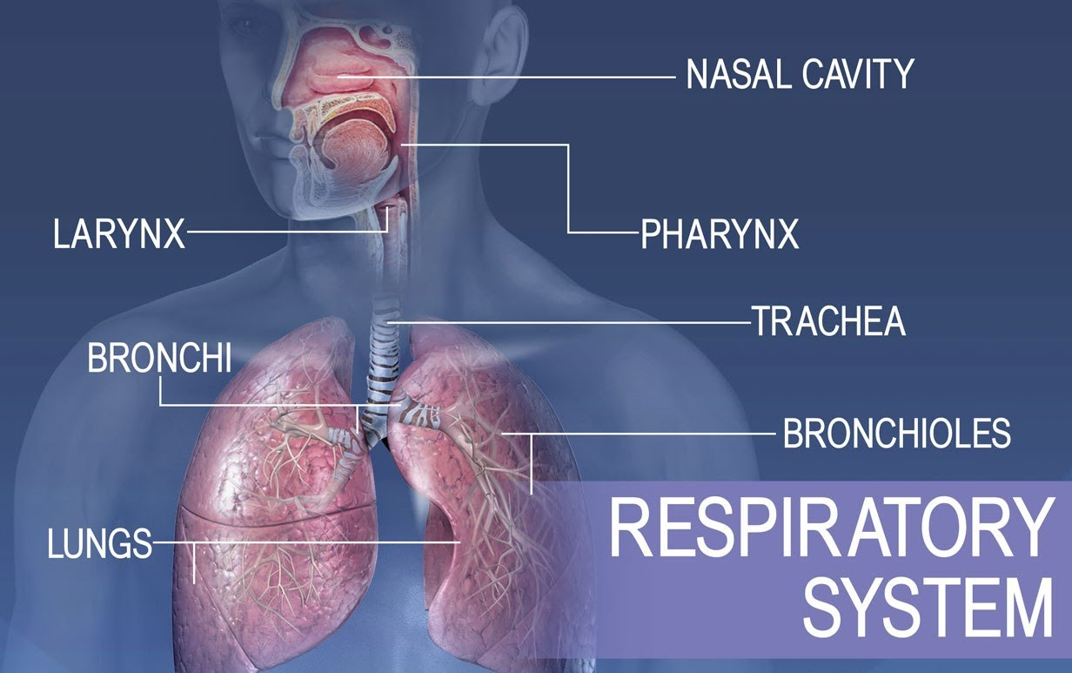

Slide 11
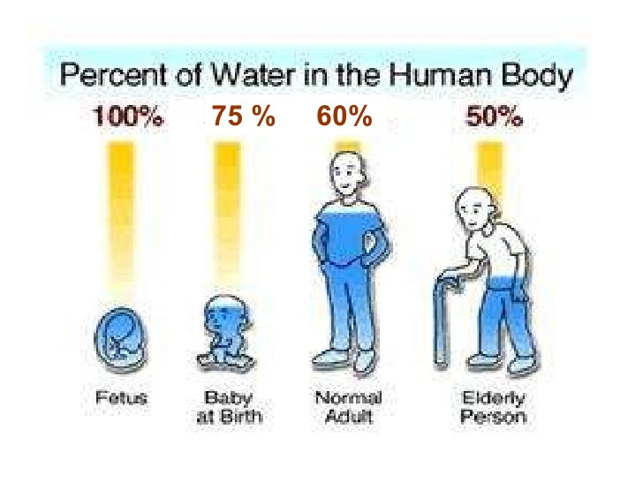

Slide 12
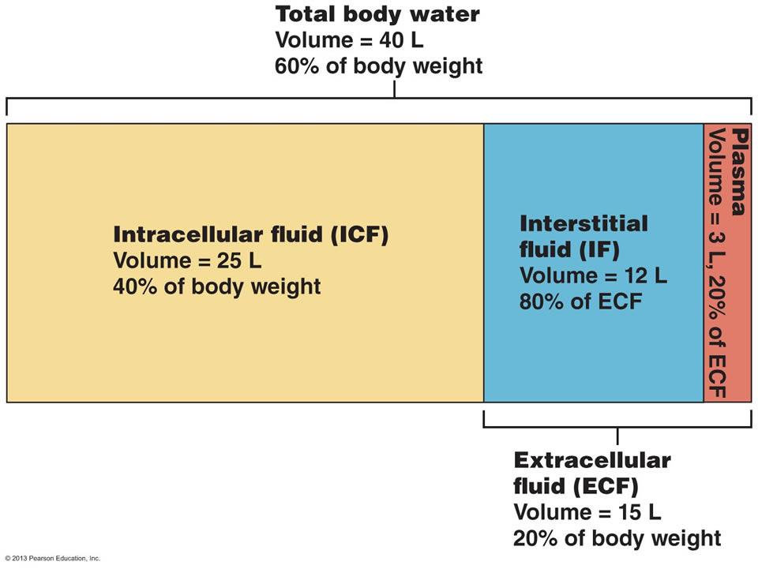

Slide 13
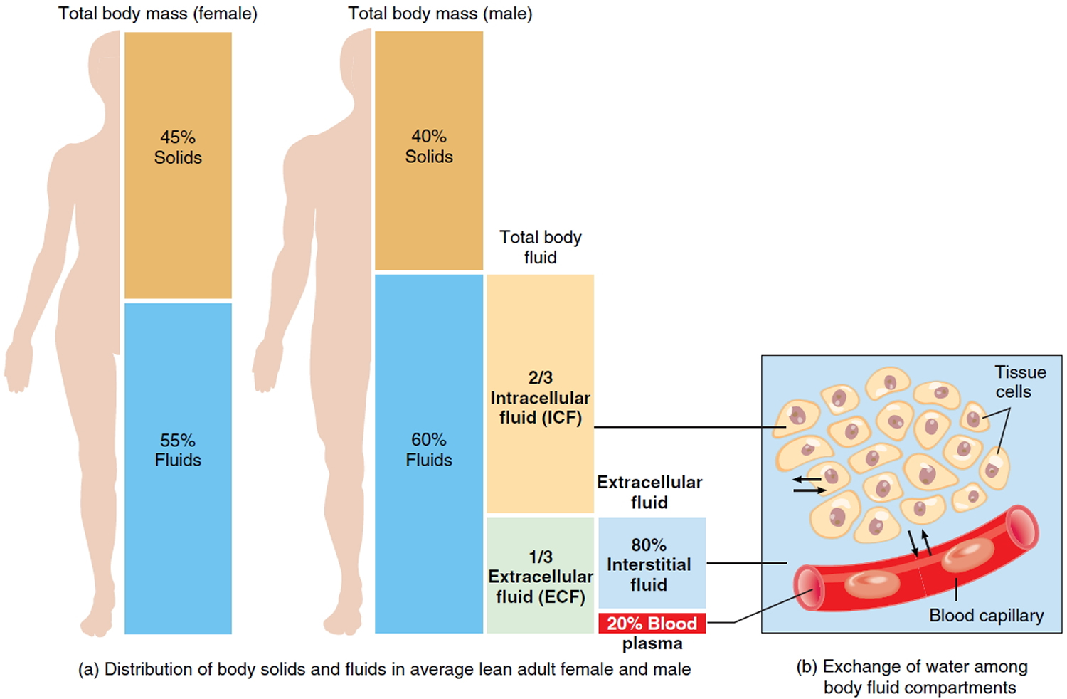

Slide 14
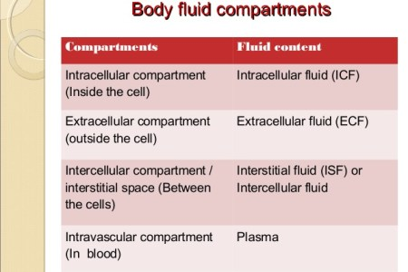

Slide 15
